Slide 1


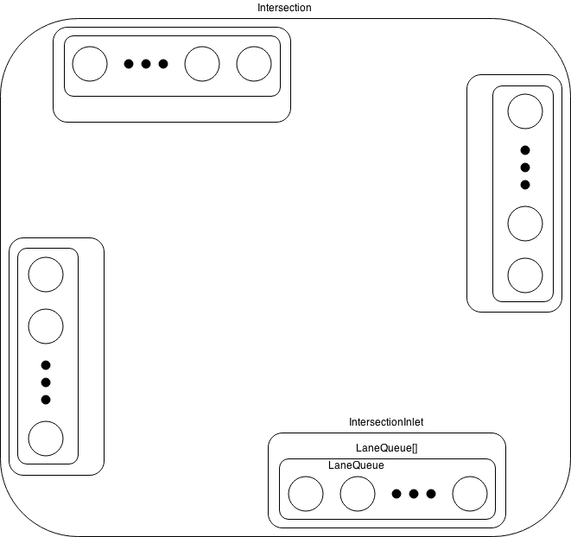
Object Oriented Traffic Simulation
By Nick Powers, and Jordan White
CS 4491 - Dr. Jose Garrido
Routing Algorithm
.
Introduction
The following outlines the development of a process-based traffic simulation. Development consisted of devising a routing algorithm, and designing concurrent software.
Routing Algorithm
.
The Interface so far
.
Intersection
How can a discrete event simulation be implemented to simulate traffic? The following outlines the development of a discrete event traffic simulation. Development consisted of devising a routing algorithm, and designing concurrent software.

